Slide 1
Machinery & Equipment Productivity Nexus Nexus Governing Council (NGC) Strategy & Action Roadmap

Slide 2
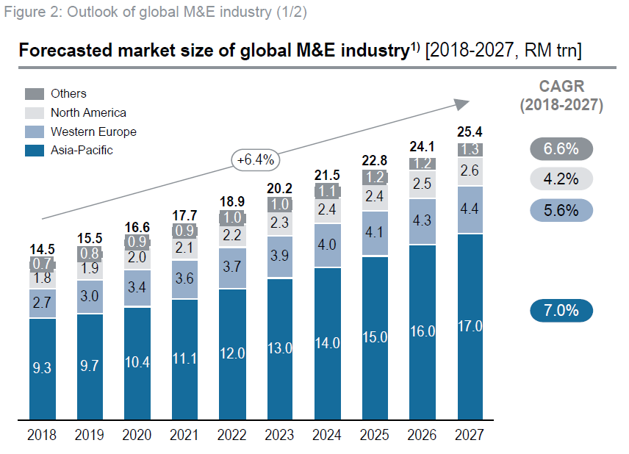
Global M&E Overview
Machinery & Equipment (M&E) is a fundamental enabler in industrial development
Forecasted global outlook for M&E (2018 – 2027)*
Total market value worth RM 25.3 trillion (CAGR 6.4% over 10 years)
By 2027, Asia Pacific is forecasted to be the largest market, accounting for ~67% of the global M&E market; worth about RM 17 trillion
In the past few years, Asia Pacific M&E market registered an average CARG rate circa 7%; the highest in the world
*Source –Berger IHS

Slide 3
Asia Pacific M&E Industry Landscape
Globally, M&E sector is forecasted to grow at CAGR > 6% per year
Asia Pacific region is the fastest growing market for M&E in the world, with an CAGR >7%
Japan, Taiwan and Korea are early leaders in M&E, including machine tools and metalworking machinery
In recent years, China and India also became active M&E players, both as consumers and suppliers
Historically, regional M&E players relied heavily on licensing and technology transfer from “traditional” sources, from Europe and the US
Currently, leading M&E players in the region already possess own IPR and are active both in the domestic and export market

Slide 4
Malaysia M&E Industry Landscape
Malaysia has the largest M&E market within ASEAN
Over the last 5 years, importation of M&E consistently exceeds export (roughly in the ratio of 2:1)
In 2016, Malaysia M&E sector recorded : -
Import value amounting to RM 65.1 billion (CAGR ~ 5.3% P.A. over 5 years)
Export value amounting to RM 37.7 billion (CAGR ~ 10.5% P.A. over 5 years)
Specialized Machinery & Equipment for Specific Industries, together with General Machinery & Equipment, Components and Parts accounts for the bulk of importation (~72% of total import valued at ~RM 65 billion )

Slide 5
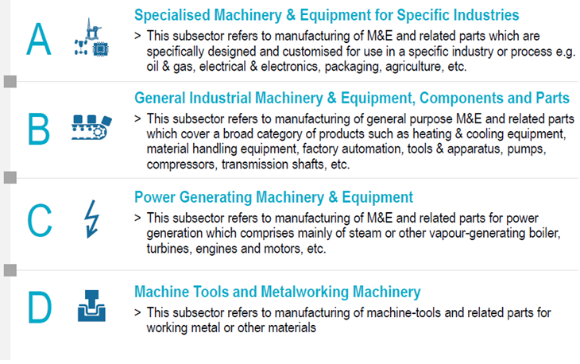
Malaysia M&E Overview
Machinery & Equipment is broadly categorized into 4 sectors, namely: -

Slide 6
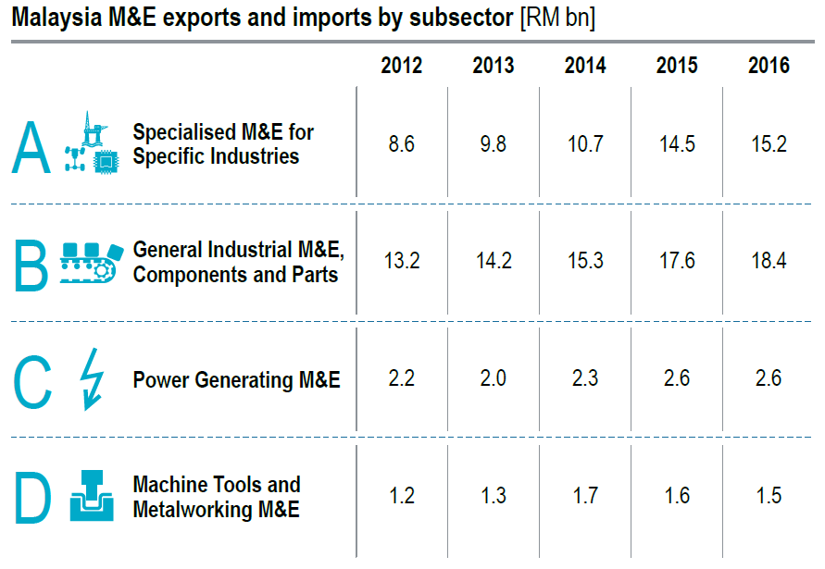
Malaysia M&E Exports and Imports
15.5 | 16.3 | 16.3 | 17.2 | 17.3
8.6 | 9.8 | 10.7 | 14.5 | 15.2
21.9 | 23.1 | 23.1 | 26.7 | 29.9
13.2 | 14.2 | 15.3 | 17.6 | 18.4
10.7 | 10.9 | 11.0 | 11.7 | 14.3
2.2 | 2.0 | 2.3 | 2.6 | 2.6
4.8 | 4.2 | 4.2 | 3.9 | 3.6
1.2 | 1.3 | 1.7 | 1.6 | 1.5
52.9 | 54.5 | 54.6 | 59.5 | 65.1
25.2 | 27.3 | 30.0 | 36.3 | 37.7
TOTAL
Import
Export
Source : HIS, Roland Berger, MIDA, MITI

Slide 7
Global Mega Trends for M&E
Heterogeneous Market
(Total Solutions)
Market increasingly demand Total Solution
Offering to include product/hardware, support, parts, tooling and integration
Rapid Digitization
Integration of machines with automation (IoT, Industrial 4.0, Artificial Intelligence
Sensors and connected devices, remote monitoring
Globalized Production
Companies are shifting their production base to lower cost areas
Closer proximity to customers with improved response time

Slide 8
Global Mega Trends for M&E
Outsourcing & Supply Chain rationalization
Corporations are increasingly relying on outsourcing to minimize capital deployed
Focused only on what they do best
Outsourcing “non-core” business activities to specialists
Shift towards Green solutions
Shift towards more energy efficient solutions
Alternative power or energy solutions
Safety, ergonomics for operators, reduced environment impacts

Slide 9
Malaysia M&E S.W.O.T.
Strengths
Malaysia has the largest M&E presence in ASEAN
Strong legacy producing specialised and general M&E for primary produce, raw materials, O&G processing, medical equipment
Successful track record in absorbing technologies from abroad, supporting MNCs
Leader in M&E for specialised M&E for the Electronics and Electrical manufacturing sector (especially in Penang)
Strong entrepreneur spirit and large SME base
Weaknesses
Many SME are not ready (motivated?) to go beyond domestic market
Heavy dependent on cheap, foreign labour
Low investments in R&D, ownership of IPR
Over emphasis on short term goals & planning, instead of long term vision
Gaps and small talent pool, especially technician level
Ineffective, poorly coordinated government initiatives
Challenging sustainability
Opportunities
Asia Pacific is the most active market, both for supply and demand for M&E in the world
Increasing integration of technology, automation in equipment
M&A opportunities with established industrial players, looking to relocate to Asia Pacific region, supporting a diversified product/service portfolio
Opening up of O&G sectors in developing countries, EOR and brown field developments (equipment supply, services and service management)
Industrial project aimed at Reduction of Carbon Footprint – potential for participation in green technology, waste recycling, energy efficiencies businesses, providing opportunities for M&E
Threats
Over reliance on cheap foreign labour, in lieu of productivity improvements
Failure to bridge talent gaps, needed to effectively execute technology enabled solutions
Disintermediation/disruption of dealer for equipment and parts sales
New competition from low-cost Chinese manufacturers, capable of offering products with good performance and increasing sophistication
Under investment in R&D and acquisition of IPR could further exacerbate competitiveness

Slide 10
Strategic Options
Options for National Governing Council for M&E to consider: -
Build on strength in specialized equipment
Capitalize on opportunities from Globalized Production, with appropriate scale
Leverage on customized equipment and solutions i.e. primary produce, oil and gas sectors
Capitalizing on outsourcing opportunities
Focus on niche sectors where Malaysia has competitive edge
Mindset change (particularly SME) towards looking beyond domestic market, plan for longer term sustainability

Slide 11
Investment Opportunities in M&E
Customised M&E
Hi-Tech M&E
Engineering Supporting Industries
Robotics & Automation
Metalworking Machinery
Packaging Machinery
Material Handling Equipment
Forging
Casting
Machining
Surface Engineering
Heat Treatment
Stamping
Mould, tool & die
Oil & Gas
Semiconductor Processing
Food & Beverage
Agricultural
Plastic Processing
Industry 4.0

Slide 12
Strategic Imperatives
Imperatives (pre-requisite enablers) that must be addressed, in order to pursue strategy and improve M&E productivity: -
Effective and consistent talent development pipeline
Stakeholders commitment to enhance productivity & efficiency
Investment in digitization technology, innovation, R&D
SME Development
Create an export mindset and enabling ecosystem
Reduce bureaucratic red tapes and duplications
Governance reform

Slide 13
Status quo is NOT an option
Malaysia’s leadership in ASEAN is not sustainable, unless proactive steps are taken to strengthen the strategic imperatives
With globalization, export is essential to sustain a viable M&E industry
Government support cannot last forever; industry must be able to stand on its own
Industry must improve productivity and invest in innovation to maintain international competitiveness

Slide 14
Recommendations – Way Forward
Nexus Governing Committee, supported by members of MEIF to propose work plans, to address the Strategic Imperatives
Work Group 1 – Plan to develop & enhance Talent Pool
Work Group 2 – Enhancing Productivity & Efficiency
Work Group 3 – SME Development
Work Group 4 – Establish an enabling eco-system and environment

Slide 15
M&E Strategic Imperatives
Propose to set up “project teams” within M&E Nexus to draw up work plan on: -
Work Group 1 - Develop & Enhance Talent pool
Identify talent gaps
Propose intervention program to nurture talents, especially at technician & vocational level
Enhance effectiveness of government - private sector collaboration
Revamp training syllabus to include digitization deployment
Work Group 2 - Enhancing productivity & efficiency
Build awareness & educate on productivity, especially amongst SME
Identify productivity gaps and put in place interventions needed
Ongoing monitoring and “handholding” to build confidence
Build and share case studies

Slide 16
M&E Strategic Imperatives
Propose to set up “project teams” within M&E Nexus to draw up work plan on: -
Work Group 3 - SME Development
Refine database of SMEs and identify promising candidates
Embark on Vendor Development program with established M&E players
Training and awareness program (mindset change)
Match making and internship program
Work Group 4 - Enabling environment
Propose harmonization, streamline government policies and procedures (enhance effectiveness and minimize “red tape”)
Coordinate export agencies e.g. Matrade, EXIM bank initiatives to facilitate export
Identify and implement M&E Eco-system

