Slide 1
M & E Nexus (Malaysia Productivity Blueprint – MPB)
By Mr. Mac Ngan Boon
President
Machinery & Engineering Industries Federation
(MEIF)

Slide 2
Machinery & Equipment (M&E) Industry

Slide 3
Global Overview
The Machinery and Equipment (M&E) industry has been of strategic importance throughout the global industrialization revolutions as one of the fundamental enablers for all economic segments such as the primary, manufacturing and services industries
The M&E industry represents one of the most innovative sectors in the economy which combines all of the key future technologies including electronics, robotics, materials and software integration and thus a key player in the next industrial revolution - Industry 4.0
Trade Statistic
Average from 2007 to 2016
Global import : USD 5.6 trillion
Global export : USD 4.2 trillion
Source: WTO

Slide 4
Malaysian Overview
Assumes strategic importance to the country’s economic transformation due to its cross cutting linkages with all economic segments such as the primary, manufacturing and services sectors.
Identified as one of the catalytic subsector identified under the 11th Malaysia Plan to spur the country’s economic transformation to greater prosperity.
Malaysia's M&E industry is among the largest and strongest in ASEAN.
The sector is dominated by mainly Malaysian-owned small and medium sized companies (SMEs)
Many of these provide customized products (end to end manufacturing – total solution providers i.e. from design to distribution) to meet the strong demand of both domestic and international manufacturing industries.
Source : MIDA

Slide 5
What is M&E

Slide 6
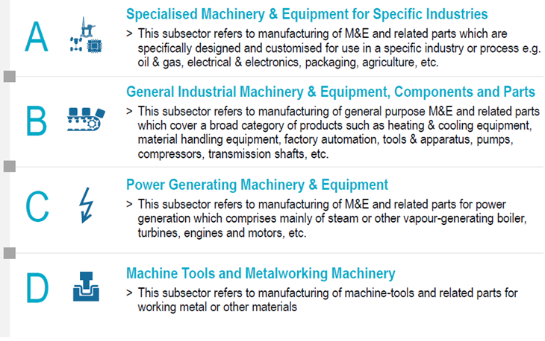
M&E Industry : 4 Main Subsectors
Source : MIDA,Roland Berger, IHS

Slide 7
M&E Ecosystem
With the current global inclination to increased outsourcing to remain competitive, the M&E industry includes a wide range of Supporting Industries and Services, essential for today’s smart manufacturing ideology
This is commonly called a complete end to end ecosystem from conceptual design to final distribution including after sales service
Moving forward, there is a need to Identify and Formalize an (already existing) ecosystem for each M&E manufacturing activity
The interconnection of the whole ecosystem through digitization and Industrial Internet of Things, to work as an integrated system is part of the shift to Industry 4.0

Slide 8
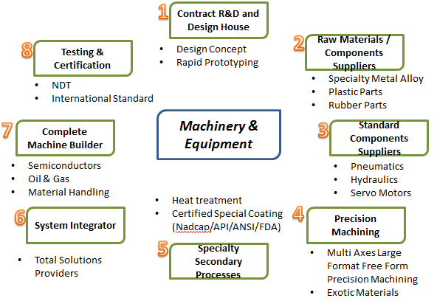
Machinery and Equipment Industry Ecosystem
Source : MIDA

Slide 9
State of the M&E Industry in Malaysia

Slide 10
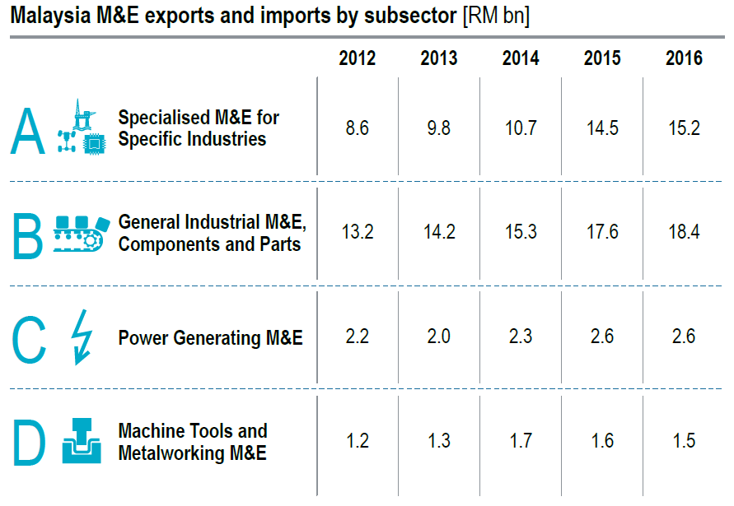
Malaysia M&E Exports and Imports
15.5 | 16.3 | 16.3 | 17.2 | 17.3
8.6 | 9.8 | 10.7 | 14.5 | 15.2
21.9 | 23.1 | 23.1 | 26.7 | 29.9
13.2 | 14.2 | 15.3 | 17.6 | 18.4
10.7 | 10.9 | 11.0 | 11.7 | 14.3
2.2 | 2.0 | 2.3 | 2.6 | 2.6
4.8 | 4.2 | 4.2 | 3.9 | 3.6
1.2 | 1.3 | 1.7 | 1.6 | 1.5
52.9 | 54.5 | 54.6 | 59.5 | 65.1
25.2 | 27.3 | 30.0 | 36.3 | 37.7
TOTAL
Import
Export
Source : HIS, Roland Berger, MIDA, MITI

Slide 11
Status of Industry
Industry Snapshot – Malaysia (2016)
Exports
RM37.7 billion#
Imports
RM65.1 billion#
Production
RM40.2 billion*
Companies
M&E (1031) , ESI (1023)
2,054
Employees
138,524
Specialised / Process M&E
Metal Working M&E
General M&E, Modules & Components
Power Generating
M&E
ESS
Sectors
Manufacturing, Services, Agriculture, Mining, Construction
Mould & Die
Forging
Machining
Surface Engineering
Stamping
Heat Treatment
Casting
* Source : MIDA; Frost and Sullivan at 2008 with consideration of 5% growth
# Matrade
ESS – Engineering Supporting Services

Slide 12
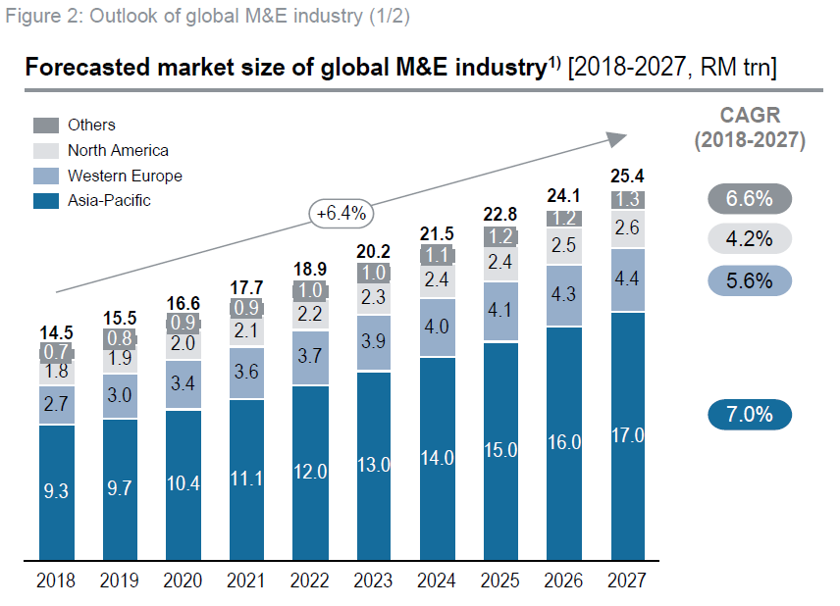
Global Machinery Production Forecast
Source : Roland Berger, IHS

Slide 13
What is Industry 4.0

Slide 14
Industrial Revolution -Industry 4.0
Fourth Industrial
revolution
Third Industrial
revolution
Second Industrial
revolution
Based on the use of cyber physical systems
First Industrial revolution
Based on the use of computer & electronics to further enhance automation
Complexity
Based on mass production enabled by electrical energy
Based on mechanical production driven by water & steam power
Factory Automation
Late 18th
century
Early 20th
century
Early 1970s
Today/in the near future
Source: BCG
Timeline
Notes:
SLIDE 9:
Slide on INDUSTRIAL REVOLUTION – INDUSTRY 4.0
The first industrial revolution in the late 18th century used water and steam power for mechanisation. The second industrial revolution came in the early 20th century used electric power to create mass production. The use of electronics and IT in industrial processes in the early 1970s represents the third industrial revolution to automate production.
Today we are in the era of fourth industrial revolution - a blend of technologies that is blurring the lines between the physical and digital spheres. “Smart production” becomes the standard where intelligent ICT-based machines, systems and networks are capable of independently exchanging and responding to information to manage industrial production processes.
Advanced digital technology is already used in manufacturing, but with Industry 4.0, it will transform production. It will lead to greater efficiencies and change traditional production relationships among suppliers, producers, and customers—as well as between human and machine.
Nine technology trends form the building blocks of Industry 4.0 (as shown in the slide) that include Autonomous Robots, Additive Manufacturing, Internet of Things, Simulation, System Integration, Cloud Computing, Big Data and Analytics, Augmented Reality and Cyber Security.

Slide 15
Industry 4.0 / 4th Industrial Revolution (4IR)
Industry 4.0 describes a future state of industry characterized by thorough digitization of economic and production flows. It requires horizontal integration at every step in the production process, in interaction with machines. In the globally interconnected world of Industry 4.0, machines also interact with one another.
9 Pillars
Autonomous Robots
Simulation
Horizontal and Vertical System Integration
Industrial Internet of Things
Cybersecurity
The Cloud
Additive Manufacturing Augmented Reality
Augmented Reality
Big Data and Analytics
No company will move from 3.0 to 4.0 in a single step. Despite its speed, this migration will take place in stages.

Slide 16
Does this apply to SME M&E Industry?
Majority of the M&E SMEs produce small batches (not mass production) or custom made to order
The following is more applicable to M&E SMEs
Bernard Marr in a Forbes magazine article said:
For a factory or system to be considered Industry 4.0, it must include:
Interoperability — machines, devices, sensors and people that connect and communicate with one another.
Information transparency — the systems create a virtual copy of the physical world through sensor data in order to contextualize information.
Technical assistance — both the ability of the systems to support humans in making decisions and solving problems and the ability to assist humans with tasks that are too difficult or unsafe for humans.
Decentralized decision-making — the ability of cyber-physical systems to make simple decisions on their own and become as autonomous as possible.

Slide 17
Global Trends for M&E
Heterogeneous Market
companies are looking to extend their product offerings beyond the traditional core market to offer integrated solutions
Vertical integration to supply chain management
Companies are now more focused solely on what they do best, i.e. specialization, with increasing trend of outsourcing for non-core activities
Increasing Cooperation
Partnerships and M&A will play a big role in growing beyond the traditional core business as building capabilities in-house can result in higher cost
Globalization of production
major companies are shifting their production base from higher cost areas to emerging markets with lower cost and closer proximity to customer; some are also engaging in distributed manufacturing model
From Manufacturing to Services
they are finding opportunities to grow their businesses by addressing customer demands for line integration and upgrade services
Brain power
companies will require talent with new skillsets and capabilities to respond to digitalization, elevating competition for talent

Slide 18
Government Strategies
In line with 11th Malaysia Plan, 8 strategic thrusts has been identified to support the national strategies such as:
Developing new talent
Enhancing productivity & efficiency
Technology, innovation & R&D
SME Development
Export Development & Promotion
Trade remedies & FTAs
Enabling environment
Governance reform

Slide 19
Enhancing Productivity & Efficiency
M&E Industry in Malaysia is dominated by local players
Most of them are SMEs unlike the E&E Industry
As such, macro policies and strategies on improving productivity may have marginal trickle down effects on the M&E Industry
For the M&E Productivity Nexus programme, in addition to the macro strategies, MEIF is working together with MPC and productivity specialists to formulate programmes specifically tailored for SMEs
MEIF will undertake special initiatives to assist a selected group of progressive SMEs to improve their productivity over a 2 year period.
Success of the initiatives will encourage more SMEs to join the fold and work with MEIF and MPC

Slide 20
Productivity
Definition
Productivity is the ability to produce output from a given set of inputs – measures the efficiency and effectiveness of resources utilisation such as employees, technology, systems and managements etc., in converting inputs into useful outputs
Some Measurements of Productivity (as obtained fro Malaysia Productivity Corporation)
Productivity = Output
Input
Labour Productivity = Total Output
No. of Employees
Capital Productivity = Total Output
Fixed Assets
Many companies in the M&E sector are labour intensive. Coupled with the employment of unskilled foreign labour, this industry’s productivity is considered relatively low.
Detailed Measurements of Productivity and Productivity Evaluation Tools are provided by MPC

Slide 21
Targeted & Projected Vision
Short term
To move towards SMART way of conducting business
To be less reliant on unskilled and semiskilled labour
To upskill existing Malaysian labour
Long term
To be cost effective and relevant in the global market
To embrace new technologies
To adopt Industry 4.0 practices company wide

Slide 22
Way Forward
First task is to tackle the challenges faced by players, mainly the SME’s in the M&E industry
MEIF was selected to champion this cause and assist the Government via MPC.

Slide 23
MEIF
MACHINERY AND ENGINEERING INDUSTRIES FEDERATION (MEIF)
Objectives:
To coordinate, promote and spearhead the progressive development of Malaysia’s machinery and engineering supporting industries to boost domestic consumption and become integrated into the global value chain
To be the collective and cohesive voice of machinery and engineering supporting industries in Malaysia and facilitate international promotional activities of its members
To act as a focal consultation point between government and its related agencies in policy advocacy, formulating strategies, incentives and strategic programme recommendations regarding issues that hamper the growth of these industries

Slide 24
MEIF
Roles and Function:
Protection of members’ legal rights
Research and survey on development of machinery and engineering supporting industries
Enhancing productivity and global competitiveness
Seminars, consultation guidance and information exchange about the industry
Promotion of international trade, investment co-operation and joint-ventures
Investigation, research and compilation of information on domestic and global machinery and engineering supporting industries

Slide 25
MEIF MEMBERS
Members:
Machinery and Equipment Manufacturers Association (MEMA)
Malaysia Special Tooling and Machining Association (MSTMA)
Formely Malaysia Mould and Die Association (MMADA)
Malaysia Automation Technology Association (MATA)
The Electrical & Electronics Association of Malaysia (TEEAM)
Small & Medium Enteprises Association of Malaysia (SME Malaysia)
Malaysia Mobile Crane Owner’s Association (MMCOA87)

Slide 26
Steps Forward
MEIF via its members (about 3000 companies) will have a diverse group of companies
MEIF will identify 20 companies to take part in a pilot trial project
These companies will work closely with MPC and MEIF to find areas of improvement that will lead to increase in efficiency and productivity
Success of the initiatives will encourage more SMEs to join the fold and work with MEIF and MPC
MEIF will also provide assistance to SIRIM/MIDA in their efforts to set up Centre of Excellence (COE) to help SMEs

Slide 27
Why…do we need to improve ?
World is getting smaller….the west is adopting new technologies and methods to increase their efficiencies and competitiveness in executing their businesses. They are moving towards industry 4.0
Our very own neighbours have upped their game and are now becoming more productive than us. In the last 8 years they have become much more efficient (eventhough they have an abundant work force)
In short….we cannot be left behind if we want to proceed with our goal to become a modern industrial and developed nation

Slide 28
What happens if we maintain status quo??
We will no longer be competitive and get left behind in all aspects of the industry
Our place on the global map will diminish
Government support cannot last forever; help and assistance will decline and we will face double jeopardy, i.e company has limited funds and government funding assistance is no longer available

Slide 29
What needs to be done?
All companies in this sector must become more efficient and move away from old school methods of doing business…so that we become competitive in this ever evolving and challenging business landscape
MEIF is fully supportive of MPC’s initiatives and we urge every member to embrace and collaborate with MPC for a better and secure future

Slide 30
Investment Opportunities
Customised M&E
Hi-Tech M&E
Engineering Supporting Industries
Robotics & Automation
Metalworking Machinery
Packaging Machinery
Material Handling Equipment
Forging
Casting
Machining
Surface Engineering
Heat Treatment
Stamping
Mould, tool & die
Oil & Gas
Semiconductor Processing
Food & Beverage
Agricultural
Plastic Processing
Industrie 4.0

