Slide 1
M & E Nexus
(Malaysia Productivity Blueprint – MPB)
By Mr. Mac Ngan Boon
President
Machinery & Engineering Industries Federation
(MEIF)

Slide 2
MEIF MEMBERS
Members:
Machinery and Equipment Manufacturers Association (MEMA)
  56 members
Malaysia Special Tooling and Machining Association (MSTMA)
  Formely Malaysia Mould and Die Association (MMADA)
  181 members
Malaysia Automation Technology Association (MATA)
  70 members
The Electrical & Electronics Association of Malaysia (TEEAM)
  1800 members
Small & Medium Enteprises Association of Malaysia (SME Malaysia)
  500 Direct members, 3000 Indirect members
Malaysia Mobile Crane Owner’s Association (MMCOA87)
  220 members

Slide 3
Machinery & Equipment (M&E)
Industry

Slide 4
Global Overview
Machinery and Equipment (M&E) industry has been of strategic importance for all the industrial revolutions
Fundamental enabler for the primary industries, manufacturing industries and also services sectors
The M&E industry is an innovative industry which combines all key technologies including electronics, robotics, materials and software integration
Will be key player in the next industrial revolution - Industry 4.0
Global Trade Statistics
Average from 2007 to 2016
Global import : USD 5.6 trillion
Global export : USD 4.2 trillion
Source: WTO

Slide 5
Malaysian Overview
M&E industry - strategic importance to the country’s economic transformation
Has cross cutting linkages with all other industries
Under the 11th Malaysia Plan - one of the catalytic subsectors for Malaysia’s economic transformation to greater prosperity.
Malaysia's M&E industry is among the largest and strongest in ASEAN.
Dominated by mainly Malaysian-owned small and medium sized companies (SMEs)
The local industry provides full machinery solutions from design to distribution
Customized or designed to order products for local and export markets
Source : MIDA

Slide 6
What is M&E

Slide 7
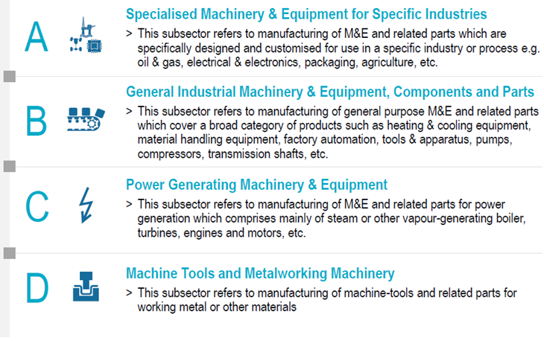
M&E Industry : 4 Main Subsectors
Source : MIDA,Roland Berger, IHS

Slide 8
M&E Ecosystem
M&E industry includes a wide range of Supporting Industries and Services
Today’s smart manufacturing ideology requires significant outsourcing
End to end ecosystem from conceptual design to final distribution including after sales service
Moving forward we need to Identify and Formalize an (already existing) ecosystem
The interconnection of the whole ecosystem through digitization and Internet of Things – major part of Industry 4.0

Slide 9
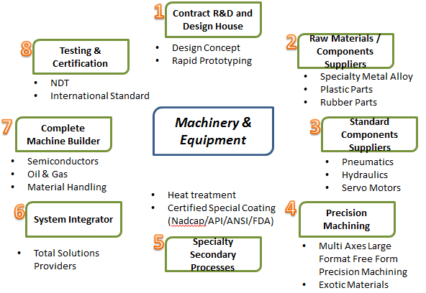
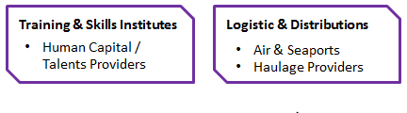
Machinery and Equipment Industry Ecosystem
Source : MIDA

Slide 10
State of the M&E Industry in Malaysia

Slide 11
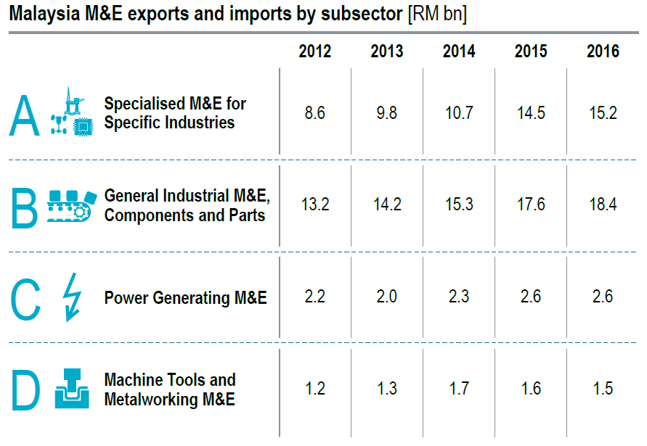
Malaysia M&E Exports and Imports
15.5 | 16.3 | 16.3 | 17.2 | 17.3
8.6 | 9.8 | 10.7 | 14.5 | 15.2
21.9 | 23.1 | 23.1 | 26.7 | 29.9
13.2 | 14.2 | 15.3 | 17.6 | 18.4
10.7 | 10.9 | 11.0 | 11.7 | 14.3
2.2 | 2.0 | 2.3 | 2.6 | 2.6
4.8 | 4.2 | 4.2 | 3.9 | 3.6
1.2 | 1.3 | 1.7 | 1.6 | 1.5
52.9 | 54.5 | 54.6 | 59.5 | 65.1
25.2 | 27.3 | 30.0 | 36.3 | 37.7
TOTAL
Import
Export
Source : HIS, Roland Berger, MIDA, MITI

Slide 12
Approved M&E Investments (2013 – 2017)
Year | No. | Potential Employment | Local Investments (RM million) | Foreign Investments (RM Million) | Total Investments (RM Million)
2013 | 90 | 4,726 | 770.0 | 1,205.0 | 1,975.0
2014 | 98 | 4,568 | 1,758.3 | 720.6 | 2,478.9
2015 | 97 | 4,428 | 964.0 | 838.4 | 1,802.4
2016 | 88 | 2,866 | 999.7 | 536.5 | 1,536.2
2017 | 77 | 6,078 | 1,431.2 | 755.0 | 2,186.2
Average Total Investments per Annum (2013 – 2017) – RM 1995.7
Source : MIDA

Slide 13
Status of Industry
Industry Snapshot – Malaysia (2016)
Exports
RM37.7 billion#
Imports
RM65.1 billion#
Production
RM40.2 billion*
Companies
M&E (1031) , ESI (1023)
2,054
Employees
138,524
Specialised / Process M&E
Metal Working M&E
General M&E, Modules & Components
Power Generating
M&E
ESS
Sectors
Manufacturing, Services, Agriculture, Mining, Construction
Mould & Die
Forging
Machining
Surface Engineering
Stamping
Heat Treatment
Casting
* Source : MIDA; Frost and Sullivan at 2008 with consideration of 5% growth
# Matrade
ESS – Engineering Supporting Services

Slide 14
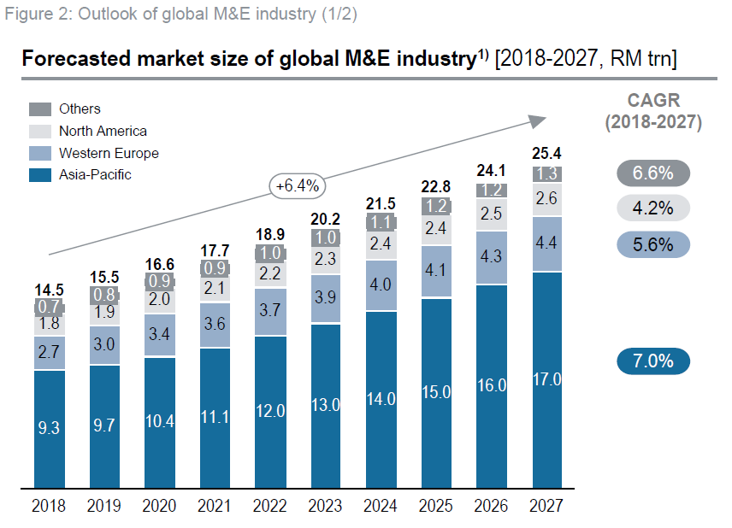
Global Machinery Production Forecast
The biggest market and growth for the next 10 years is ASIA
Source : Roland Berger, IHS

Slide 15
M&E and Industry 4.0

Slide 16
Global Trends for M&E
Malaysia has achieved a high level of industrial development
We cannot continue to make same things as before which is being made by emerging economies like Vietnam, Indonesia, Myanmar, Philippines
Must move up the value chain to produce higher value added products and compete with developed nations
Strategic partnerships, technology development, technology acquisitions, mergers and acquisitions
Provide total solutions, not just products
Outsource more to remain competitive and stay ahead on technology
Upskill current workforce to new skillsets and capabilities to respond to digitalization,
To be on par with developed nations we have to move into Industry 4.0

Slide 17

Industrial Revolution -Industry 4.0
Fourth Industrial
revolution
Third Industrial
revolution
Second Industrial
revolution
Based on the use of cyber physical systems
First Industrial revolution
Based on the use of computer & electronics to further enhance automation
Complexity
Based on mass production enabled by electrical energy
Based on mechanical production driven by water & steam power
Factory Automation
Late 18th
century
Early 20th
century
Early 1970s
Today/in the near future
Source: BCG
Timeline
Notes:
SLIDE 9:
Slide on INDUSTRIAL REVOLUTION – INDUSTRY 4.0
The first industrial revolution in the late 18th century used water and steam power for mechanisation. The second industrial revolution came in the early 20th century used electric power to create mass production. The use of electronics and IT in industrial processes in the early 1970s represents the third industrial revolution to automate production.
Today we are in the era of fourth industrial revolution - a blend of technologies that is blurring the lines between the physical and digital spheres. “Smart production” becomes the standard where intelligent ICT-based machines, systems and networks are capable of independently exchanging and responding to information to manage industrial production processes.
Advanced digital technology is already used in manufacturing, but with Industry 4.0, it will transform production. It will lead to greater efficiencies and change traditional production relationships among suppliers, producers, and customers—as well as between human and machine.
Nine technology trends form the building blocks of Industry 4.0 (as shown in the slide) that include Autonomous Robots, Additive Manufacturing, Internet of Things, Simulation, System Integration, Cloud Computing, Big Data and Analytics, Augmented Reality and Cyber Security.

Slide 18
M&E SMEs and Industry 4.0
Industry 4.0 describes a future state of industry
Digitization of production process flows, human to machine interaction, machine to machine interaction
Globally interconnected world using Cyberspace
It involves the 9 pillars - Autonomous Robots, Simulation, Horizontal and Vertical System Integration, Industrial Internet of Things, Cybersecurity, The Cloud, Additive Manufacturing, Augmented Reality, Big Data and Analytics
One size fits all - does not apply to Industry 4.0
Majority of Malaysian M&E SMEs produce small batches (not mass production) or customized solutions
Identify which are the pillars best suited and modified for Machinery and Equipment SMEs
Most important aspect of Industry 4.0 - increase in productivity and efficiency
No company will move from 3.0 to 4.0 in a single step. Despite its speed, this migration will take place in stages.

Slide 19
Government Strategies
In line with 11th Malaysia Plan, 8 strategic thrusts has been identified to support the national strategies such as:
Developing new talent
Enhancing productivity & efficiency
Technology, innovation & R&D
SME Development
Export Development & Promotion
Trade remedies & FTAs
Enabling environment
Governance reform

Slide 20
Way Forward
For the M&E Industry, the MEIF was selected to champion this cause and assist the Government via MPC.
First task is to tackle the challenges faced by players, mainly the SME’s in the M&E industry
The current levels of productivity and efficiency must be increased well before embracing Industry 4.0

Slide 21
Challenges
M&E Industry in Malaysia is dominated by local players
Most of them are SMEs
Many companies in the M&E sector are labour intensive using unskilled foreign labour - productivity is considered relatively low.
Macro policies and strategies alone will not have the desired effect of increasing productivity and efficiency in the M&E Industry
For the M&E Productivity Nexus programme, in addition to the macro strategies, MEIF will work together with MPC and productivity specialists to formulate programmes specifically tailored for SMEs
MEIF will undertake special initiatives to assist a selected group of progressive SMEs to improve their productivity over a 2 year period.

Slide 22
Targeted & Projected Vision
Short term
To move towards SMART way of conducting business
To identify ecosystem players for the formation of virtual clusters
To upgrade and update production processes
To be less reliant on unskilled and semiskilled labour
To upskill existing Malaysian labour
Long term
To be cost effective and relevant in the global market in preparation for internationalization
To embrace new technologies
To adopt Industry 4.0 practices company wide

Slide 23
Broad Strategies
Enhancing productivity
  direct engagement with selected SMEs
Building workforce of the future
  upskilling existing talent at technician, engineer and professional levels
Setting up virtual clusters to enhance competitiveness
  identify SME ecosystem players, value chain and compile database, directory
Adopting Industry 4.0
  embrace latest technologies, enhance R&D and innovation, digitization
Setting up the M&E Centre of Excellence for SMEs
  work with MIDA, SIRIM and other Government agencies

Slide 24
Steps Forward
MEIF via its members (about 3000 companies) will have a diverse group of companies
MEIF will identify 20 companies to take part in a pilot trial project
These companies will work closely with MPC and MEIF to find areas of improvement that will lead to increase in efficiency and productivity
MEIF will also provide assistance to SIRIM/MIDA in their efforts to set up Centre of Excellence (COE) to help SMEs upgrade technology and take steps towards Industry 4.0
MEIF will work with MIDA to identify full ecosystem players for the M&E Industry
MEIF will collaborate with training institutes and institutes of higher learning on the specific needs of the industry

Slide 25
Threats
World is getting smaller
The west is adopting new technologies and methods to increase their efficiencies and competitiveness
Our very own neighbours have upped their game and are now becoming more productive than us
We will no longer be competitive and will get left behind in all aspects of the industry
Our place on the global map will diminish
Government support cannot last forever, and while the support is still there, we need to improve and be independent

Slide 26
What needs to be done?
In Conclusion
All companies in this sector must become more efficient and move away from old school methods of doing business…so that we become competitive in this ever evolving and challenging business landscape in order to become a modern industrial and developed nation
MEIF is fully supportive of MPC’s initiatives and we urge every member to embrace and collaborate with MPC to adopt the Malaysia Productivity Blueprint (MPB) for a better and secure future

Slide 27


