Slide 1
MEIF
Committee Meeting
Proposed Action Plan & Calendar
2021
Eastin Hotel, Petaling Jaya
18th March 2021

Slide 2
Recap - MEIF AGM (24 September 2020)
Recommendations
MEPN to continue efforts to build effective bridge between public and private sectors towards improving productivity
Build on the MEVAC (M&E Virtual Advisory Clinic) initiative that proved successful to engage M&E players, who are willing to adopt changes
MEPN initiatives to enhance awareness, support available and importance of productivity gains, essential to ensure sustainability through main stream and social media
Encouraging use of MPC online productivity and business excellence evaluation tools to determine current productivity base lines and “Qualitative” results
Continue to invest in building momentum to make “Quantitative” productivity improvements
Encourage “Blue Ocean” thinking and prepare to challenge entrenched “status quo” mentality, especially among SMEs
MEPN appeals to MEIF members to disseminate information of assistance and support available; members are welcomed to participate in programmes meant to assist enterprises in the M&E sector

Slide 3
MEIF Committee meeting – 18 March 2021
As of end February 2021: -
Some success in creating better awareness of productivity
Bridging of understanding between public and private sectors
  Engagements through printed media (English & Chinese)
  Engagement through electronic/broadcast media (ASTRO, eStar)
  Engagement through Social Media (WhatsApp, Facebook)
2019 -2020 Improvement Roadmap
  Projects progress are slower than plan
  MEPN Work Groups KPIs not yet achieved
  Still facing low “Buy-In” at members and enterprise level
  Low participation rate, much short of the 15~30 nos. from each MEIF associations

Slide 4
The M&E Productivity Nexus working groups have identified a total of 14 projects for 2019-2020
WG1 : Talent and
Manpower
WG2 : Productivity and
Efficiency
WG3 : SME Empowerment and Development
WG4 : Ecosystem
(Policies & Procedures)
Set up partnership between government and industry associations to up-skill existing employees
Set up Centre of Excellence for skilled professionals to share industry expertise and develop new technologies
Set up more product testing facilities to ensure standards are met
Update of domestic product standards to be at par with international standards and enforce compliance
Sectoral
Initiatives
7
9
1
5
Industry Association-led efforts to enhance SME capabilities by leveraging on product testing facilities & Industry 4.0 funds, and cluster SME members for joint proposals to export products
Emphasis on procurement to be based on compliance to export quality standards to elevate Malaysian SMEs capabilities
University-Industry-Govt-Civil Society partnership for M&E Talent Development Roadmap aligned to Industry 4.0
Create targeted awareness programmes and leverage on existing MPC productivity tools and Govt grants to improve productivity
10
2
6
Streamlining of targeted processes and regulations on a prioritised basis
Encourage more industry-driven apprenticeship programmes via the Nexus and recognition for industry champions which deliver
Optimising functions of COEs through effective partnerships
8
Development of a comprehensive repository of the M&E supply chain to encourage development of end-to-end solutions
11
Govt to re-include Industry Associate representatives into key Approval committees for Govt incentives to build up agency knowledge and familiarity
3
Projects
Upskilling existing employees and trainers through partnership between industry and TVET
Projects
4
12
Development of a web-based one-stop center for M&E Human Capital Development
Improvement to the SST regime to encourage in-country value-add activities
13
Streamlining of import duties to encourage in-country value-add activities
14
M&E companies to be required to be industry association members to qualify for Govt incentives

Slide 5

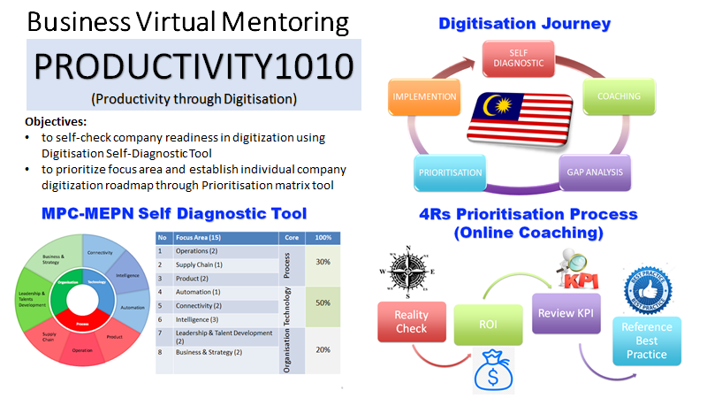
MEIF Committee meeting – 18 March 2021
MPC “Go Digital” Programmes: -
MEVAC – launched at the onset of MCO during 1st Half of 2020 with enthusiastic response from >50 participants, but interest waned in 2nd Half 2020
Productivity 1010 programme – productivity improvements leveraging on digital solution is quite well received by companies

Slide 6
MPC Digital Productivity Programmes

Slide 7
Common Findings & Feedbacks
Machinery & Equipment Sector : -
  Approximately 85% are Small & Medium Enterprises (SME)
  Typical “Value Added” content achieved ≤15% of revenue
  Large variation in technology & innovation adoption
  Differing view on how productivity impacts business sustainability
  “Red Ocean” strategy predominates
Common Issues & Challenges cited by the M&E sector : -
  Talent & Manpower
  Technology & Innovation adoption to enhance Productivity
  SME empowerment & Development
  Improve the M&E eco-system (policies & procedures)
Profitability takes precedent over productivity
“Silos” - Public agencies and Private enterprises

Slide 8
 | LLC | SME | MNC
Planning | Longer term (>3 years) | Short term, immediate | Strategic (≥ 5 years)
Geographic scope | Regional & Domestic | Domestic focus | Global
Innovative mindset | Embrace/embedded | Passive-Reactive | Encoded
Digitization & technology adoption | Intermediate | Ad-hoc, discrete equipment, rather than system | Encoded
Management focus | Targeted investment to sustain business, driven by regulations | Short term profit, survival | Long term sustainability, plus corporate image, safety important
Operation excellence | System and process improvements on need basis | Ad-hoc, reactive | Strong emphasis on lean processes, dedicated resources to realize continuous improvements
Productivity priority | Soft targets | Typical no formal target | Hard, stretched targets

Slide 9
Machinery & Equipment
Virtual Advisory Clinic
Typical issues raised during MEVAC

Slide 10
MEIF meeting – 18 March 2021
Proposed Action Plan for 2021 (Endorsed by MEPN NGC): -
Goals
  Shift focus from Productivity Awareness to delivering tangible and measurable outcomes
  Align goals and strategy among stakeholders (MEPN, MPC, MEIF, Enterprises etc)
MEIF associations to lead and improve individual enterprises’ meaningful participation
Agree on resources to execute strategy (Where? How much? When? Who?)
Update 14 projects in 2019-2020 Roadmap by Work Groups, re-define KPIs & measurements
Leverage on allocated resources to MPC for digital and improvement programmes e.g. P1010, MEVAC etc.
Goal theme – tangible OUTCOME, scale capable to “Move the Productivity Needle”

Slide 11
MEIF meeting – 18 March 2021
Business Virtual Mentoring Programmes
Productivity 1010 MEVAC Cluster
Work Groups
Talent & Manpower
Productivity
&
Innovations
SME Empowerment
Eco-system
Self diagnostic tool to determine digitization readiness
Prioritize and determine areas to digitize
Aim at improving overall productivity
Virtual Advisory Clinics open to M&E, other Malaysian businesses
Channel for enterprises to raise industry related issues
Dialogue with advisors from industry
Services offered free of charge to participants
Physical or virtual clusters to achieve higher capabilities and capacities to serve industry
Clusters have proven to be highly effective in Germany, Taiwan etc.
Link to Centre of Excellence (COEs)
WG 1
WG 2
WG 3
WG 4

Slide 13
Proposed Way Forward
For
MEIF & MEPN
2021

Slide 14
MEIF meeting – 18 March 2021
Proposed Action Plan & Calendar for 2021: -
Action | By Whom | Timeline
Align & endorse the proposed MEIF 2021 Action Plan | MEIF Members representative | March 2021
Respective MEIF member associations to hold forum on productivity & programmes for committee/members, facilitated by MPC/MEPN | MSTMA/MEMA/TEEAM/ MATA/MMCOA1987/ SMEAM Association President, Secretariat | March ~ April 2021
Target 150 companies from MEIF to participate in at least one MPC productivity programme within 2021 | MEIF Secretariat & associations | April to November
3 Training sessions on digital solutions to improve productivity e.g. Field Service Management (FSM), Customer Relationship Management (CSM), Smart Manufacturing & Lean processes | MEPN/MPC/MEIF & Training Provider | April to November
Cooperation from each associations to get their members to participate in various improvement programmes is crucial to achieve the desired outcome

Slide 15
Thank You

Slide 16
Examples of MEVAC Follow up

Slide 17
Example of MEVAC follow up: -
New Market Development & Export
Typical Challenges faced : -
How to expand into a new (particularly export) market?
Readiness to export?
Insufficient scale to participate in large order quantities
Highly competitive landscape, especially against Chinese players
Follow up actions taken: -
Ongoing engagements with MATRADE
Assessment using ERAT (Export Readiness Assessment Tool)
Identify potential interventions to close internal and/or external gaps
Networking & buyer – seller linkages

Slide 18
Example of Digitalization solution
Customers and assets management outsider company premises : -
Typical Challenges faced in Field Service Management (FSM): -
Scheduling and dispatching of technicians
“Invoice shocks or surprises” – disputes and long delays over billing
“Mileage” claim disputes
Journey management related issues (road accidents, traffic related offences involving company vehicles)
Low “First time-fixed-rate”
Limited access to previous work done and service history for equipment
Multiple trips to get parts and manuals
Billing delays and disputes
Manual intervention to settle disputed claims
Delays and errors in data entry to accounting system

Slide 19
Field Service Management (FSM)
What a typical FSM includes: -
Manage technicians activities
Real time location of service vehicles
Scheduling and dispatching of technicians
Monitor & help to ensure driver safety
Access to work and parts manuals
Inventory of parts and consumables
Billing & accounting (if necessary)
Time management
Link to back office (if necessary)
FSM Benefits: -
Better able to meet Customers Expectations
Better utilization of equipment and manpower
Higher productivity & cost management
Increase “first time-fixed-rate”
Access to data and technology
Reduce data entry & errors
Reduce “invoice shocks” & disputes
Audit trial and history

Slide 20


Field Service Management (FSM)
Some Examples : -
https://youtu.be/xSkJAUr7jAg
https://youtu.be/JVN1tPYAWSo
https://www.youtube.com/watch?edufilter=NULL&v=n7LdSTadt4E
https://www.ifs.com/corp/solutions/service-management/mobile-field-service/#

Slide 21
Field Service Management (FSM)
FSM are available either as a module, integrated within a main stream ERP software or stand-alone installation
Integrated ERP e.g. Microsoft Dynamics 365, IFS and many others
Stand-alone solutions, typically available on Cloud subscription can be a starting point (combined with accounting software in varying extent)
Salesforce.com – outsourced end-to-end back office services provider on subscription through Cloud computing
FSM and CRM are often offered in combination
MEPN is engaging Malaysia IT companies e.g. SalesConnection, Censoft (Acumatica solutions), Openwave Computing to find customised and affordable solutions

Slide 22
MEPN Industry Cluster Programme
Presented By N. Sangaran
15th March 2021

Slide 23

















Pharmaceutical Ecosystem
Value Chain
R&D, Clinical studies, BA/BE Testing, NCE
Materials (APIs, excipients, herbal extracts)
Process/
Technology, e.g: Cleanroom
Pharmaceutical Products
SYMBIOTICA SPECIALITY INGREDIENT
Major Players Operating in Malaysia
SARAWAK BIODIVERSITY CENTER
INFO KINETICS
SM BIOMED
BIOTROPIC
NOVA LABORATORIES SDN BHD
(Ranbaxy)
Supporting
Local suppliers:
Medical
packaging
Components/
machinery’s
part suppliers
Local services:
Sterilisation
Clean Room
Universities
Certification
consultants
Finance/funding
venture capitalist
Clinical Trial Network
BA/BE studies
GMP
Halal Certification
Member of PCT
Industry
Group
Policies,
Regulations & Incentives
MIDA, MOH, Malaysian Intellectual Property (MYIPO), National Biotechnology Policy (NBP)
Human Capital Development
Public & Private Universities

Slide 24

M&E Ecosystem in Malaysia
Material
Fabricators
Component
Modules
Machine Builders
Specialty metal alloy Plastic parts Rubber parts Standard components
Machine structure Sheet metal processing
Machining Casting Stamping Mould, Tools & Dies Surface treatment Heat treatment Specialty processes
Process modules System Integrator
Original Equipment Maker Contract Manufacturers Original Design manufacturers
Total Solution Providers
Internet of Things
Big Data Analytics
Cloud Computing
Robotics
Additive Manufacturing
Simulation

Slide 25
Industry Cluster and Functioning Industry Cluster
An Industry Cluster is actually a physically or virtually interconnected ecosystem
A functioning or operational industry cluster is one which has component companies with varying specialties working and cooperating together to provide a collective product or service solution rather than marketing their individual specialties.
Corporations are more and more, outsourcing their requirements to supply partners, and focusing their resources more on R&D, innovation and special propriety technology or component to remain competitive
Corporations prefer to manage a few solution providers rather than a gamut of individual suppliers.
Clusters have a specific theme, a clear organization (legal entity) with a contact person and a management team to manage and fairly allocate and monitor progress of incoming business and be responsible for successful completion and delivery.
Flexibility and speed in cross-company collaboration is what distinguishes an operational industry cluster from other business setups as corporations can add the punch to quickly grow innovative ideas into profitable operations.

Slide 26
Why Clusters Matter
Most SMEs in Malaysia are small. Only a few develop into big players in the global scene.
In the highly competitive global market, being small is a big hurdle to success. As such if SMEs can pool their resources, capabilities and specialties to represent a bigger entity or cluster, supplying a total or complete solution, success in the global market will be much more assured
Operational clusters are the only viable alternative for the future growth of Malaysian SMEs.
With Malaysia moving into high technology, high value added, low volume, high mix industries, SMEs need to enhance their technologies and specialties to become strong niche market players.

Slide 27
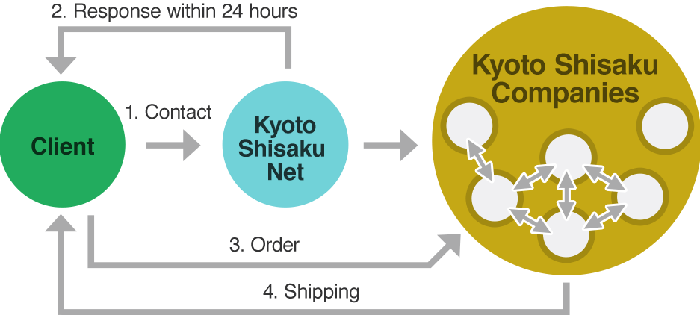
Kyoto Shisaku Net Group

Slide 28
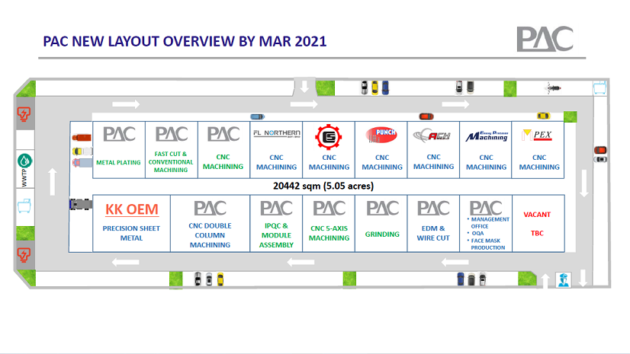

Slide 29
Way Forward

Slide 30
Key Success Factors for Clusters
Identify right growth products/subsectors or stakeholders
Strong and committed leadership
  - Individual Personality
  - Strong leader company
  - Future Growth Stakeholder
  Strong capable cluster management
  Committed component members
  Component companies must be specialist in their own fields
    willing to adopt latest technologies within their fields
    willing to adopt internationally recognized standards
    willing to expand R&D facilities and expenditure
    willing to contribute to stakeholders product improvement
    Component companies must adopt Industry 4.0 initiatives especially Digitalisation

Slide 31
Follow-up Steps
Identify Industry Niche Product Subsectors by Industry Association/MIDA (including heavy construction and shipbuilding, aerospace, medical devices)
Identify leader company or companies by Industry Association/MIDA
Training and Briefings by local/foreign cluster experts or existing successful clusters (MEPN)
MIDA, MITI and EPU endorsement of clusters with assistance and incentive programmes
Secure banks participation
Cyber Interconnectivity among members of clusters is key to success and thus MDEC can play a role
Buy Malaysia programme to support these clusters
MATRADE and MIDA to promote the clusters globally

Slide 32
Working Group
Group Head: Mr. Alan Tan (SMEMalaysia)
Facilitator: Mr. N. Sangaran
Members: Current SMEMalaysia cluster experts, Association representatives
Govt.: MPC, MIDA, MATRADE
Advisor: Mr. Ricky Soo
International Assistance: JICA, APO
Target: 3 new clusters by end 2021 (with MoU or LoI), followed by pilot projects by 2022

Slide 33
THANK YOU

